Slide 1
TREATMENT OF T2DM: A RATIONAL APPROACH BASED UPON ITS PATHOPHYSIOLOGY
Ralph A. DeFronzo, MD
Professor of Medicine
Chief, Diabetes Division
UT Health, San Antonio, TX

Slide 2
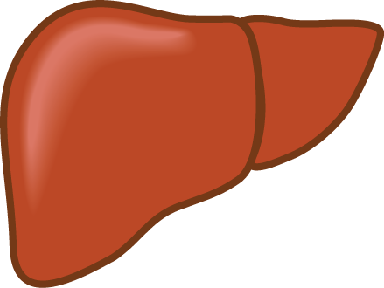
THE TRIUMVIRATE
Impaired Insulin Secretion
Hyperglycemia
Decreased Glucose
Uptake
Increased
HGP
DeFronzo RA, Diabetes 37:667-687, 1988

Slide 3
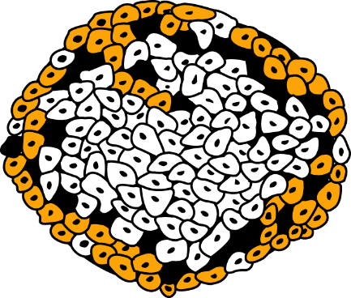
OMINOUS OCTET
Decreased Incretin Effect
Decreased Insulin Secretion
Increased
Lipolysis
Islet–α cell
HYPERGLYCEMIA
Increased
Glucose
Reabsorption
Increased Glucagon Secretion
Increased
HGP
Decreased Glucose
Uptake
Neurotransmitter Dysfunction
Diabetes 58:773-795, 2009

Slide 4
TREATMENT OF T2DM
(1) Will require multiple drugs in combination to correct multiple pathophysiologic defects
(2) Should be based upon known pathogenic abnormalities, and NOT simply on the reduction in HbA1c
(3) Must be started early in the natural history of T2DM, if progressive beta cell failure is to be prevented

Slide 5
UKPDS: Effect of SU & Metformin Rx on HbA_{1c}
9
Glibenclamide
Conventional
8
37%
Metformin
Median HbA_{1c} (%)
7
6
0
0
3
6
9
12
15
Time (years)
UKPDS 352:837-853 and 853-865, 1998

Slide 6
15 YEAR “REVELATION”
UKPDS - 1990
ADOPT - 2005
GRADE - 2020
Stepwise therapy with metformin and sulfonylureas (and DPP4i) fails to reduce and maintain the reduction in HbA1c

Slide 7
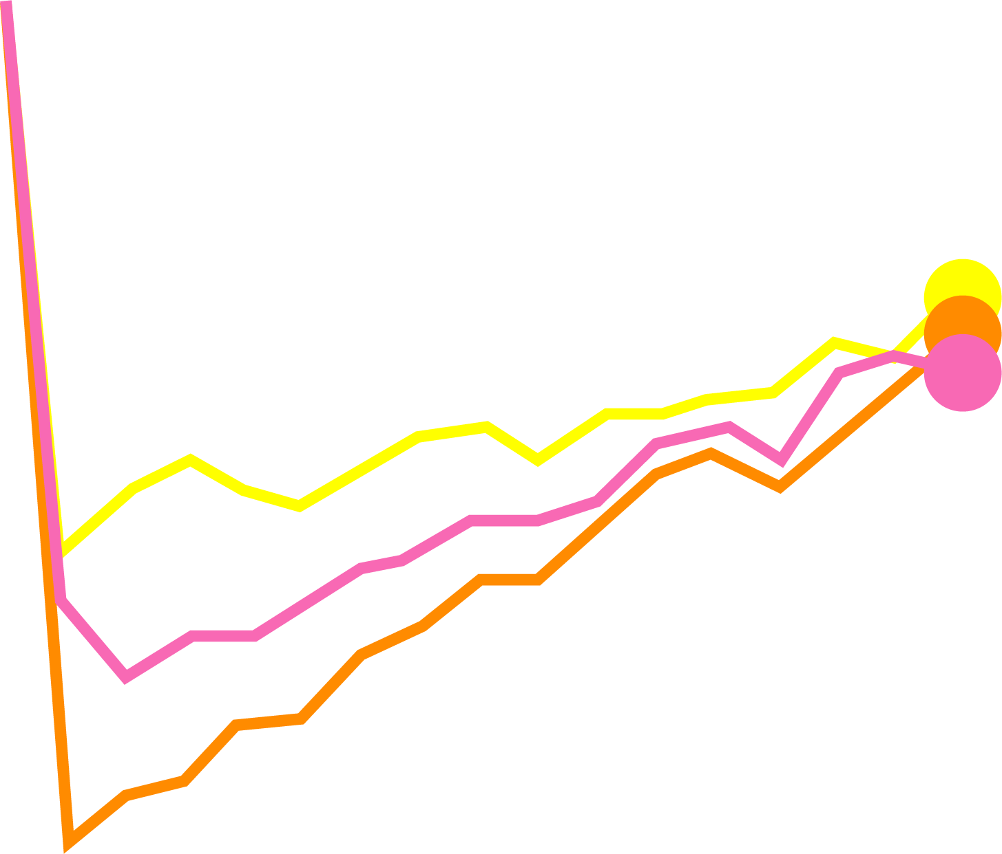
HbA1c LEVELS IN GRADE
Glycemia Reduction Approaches in Diabetes – A Comparative Effectiveness (Grade Study)
NEJM 387:1063-74, 2022
7.4 -
N=5,047
Metformin failure
A1c = 6.8-7.5
Glimepiride
7.2 -
Sitagliptin
Liraglutide
HbA1c (%)
Glargine
7.0 -
6.8 -
6.6 -
Kruskal-Wallis p<0.001 At year 4.
0
6
12
18
24
30
36
42
48
54
60
Month

Slide 8
OMINOUS OCTET – METFORMIN AND SU
Decreased Incretin Effect
GLP1
Decreased Insulin Secretion
Increased
Lipolysis
Islet–α cell
HYPERGLYCEMIA
Increased
Glucose
Reabsorption
Increased Glucagon Secretion
Increased
Decreased Glucose
Uptake
HGP
MET
Neurotransmitter Dysfunction

Slide 9
DURABILITY OF GLYCEMIC CONTROL WITH THIAZOLIDINEDIONES
1
Hanefeld (n=250)
Chicago (n=232)
Charbonnel (n=317)
ADOPT (n=1,456)
PERISCOPE (n=178)
Rosenstock (n=115)
RECORD (n=301)
Tan (n=249)
0
PIO
Rosiglitazone
Change in HbA1c (%)
PIO
ROSI
-1
PIO
PIO
PIO
-2
0
1
2
3
4
5
6
TIME (years)
Notes:
9

Slide 10
EFFECT OF THIAZOLIDINEDIONES ON INSULIN-MEDIATED GLUCOSE DISPOSAL
Miyazaki & DeFronzo, Diabetologia 44: 2210, 2001
Diabetes Care 24: 710, 2001
*
*
10
8
GLY
SYNTH
mg/kg FFM•min
6
4
GOX
0
Before
PIO
ROSI

Slide 11
EFFECT OF TZDs ON BETA CELL FUNCTION
1
IR
2500
Before Rx
After Rx
*
x
2000
*
1500
1000
Δ ISR (AUC)
Δ Glucose (AUC)
500
0
Naïve
+ Placebo
Naïve
+ PIO
Naïve
+ ROSI
Gastaldelli, DeFronzo et al, AJP 292:E871-83, 2007

Slide 12
OMINOUS OCTET - PIOGLITAZONE
TZDs
TZDs
Decreased Incretin Effect
GLP1
Decreased Insulin Secretion
Increased
Lipolysis
Islet–α cell
HYPERGLYCEMIA
Increased
Glucose
Reabsorption
Increased Glucagon Secretion
Increased
Decreased Glucose
Uptake
HGP
Neurotransmitter Dysfunction
TZDs
TZDs

Slide 13
PROACTIVE
In high risk type 2 diabetics:
To examine whether pioglitazone reduces total mortality and macrovascular morbidity
19 European Countries
5238 Type 2 Diabetics

Slide 14
PIOGLITAZONE REDUCES CARDIOVASCULAR EVENTS
PROACTIVE (n=5238):
TIME TO DEATH, MI, OR STROKE
LANCET 366:1279-89,2005
0.15
Placebo
# Events
3 Year
Estimate
HR =
0.84
Plc
358
14.4%
0.10
PIO
301
12.3%
Kaplan-Meier Event Rate
Pioglitazone
0.05
P=0.027
0
0
12
24
36
TIME (months)

Slide 15
Glucagon-like Peptide 1 (GLP-1) and Glucose-Dependent Insulinotrophic Polypeptide (GIP) account for ~90% of the incretin effect and 60-70% of insulin secreted during a meal
INCRETINS
In response to equivalent hyperglycemic stimuli, ORAL glucose elicits a greater insulin response than IV glucose

Slide 16
GLP-1 ANALOGUES
Exenatide BID (Byetta)
Lixisenatide (Adlyin)
Liraglutide (Victoza)
Exenatide QW (Bydureon)
Albiglutide QW (Tanzeum)
Dulaglutide QW (Trulicity)
Semaglutide QW (Ozempic)
Semaglutide – oral (Rybelsus)
Tirzepatide (Mounjaro)
GLP-1 RA/GIP/GLUCAGON (Ritatrutide)
Cagrisema

Slide 17
GLP-1 RECEPTOR AGONISTS
Effectively reduce HbA_{1c}
Preserve beta cell function
Inhibit glucagon secretion
Promote weight loss
Correct 6 of the pathophysiologic defects in T2DM
Do not cause hypoglycemia
Have an excellent safety profile
Reduce cardiovascular events
Rad 03/20/00
Triplitt & DeFronzo, Expert Rev Endo Metab 1:329-41, 2006
Notes:
17

Slide 18
TIME COURSE OF EFFECT OF EXENATIDE
ON HbA_{1c}
Time (weeks)
0
20
40
60
80
156
0.5
Placebo
Baseline HbA_{1C}=8.3%
0
Exenatide-
10 μg bid
DeFronzo et al, Diabetes Care
28:1092-1100, 2005
Δ HbA_{1c} (%)
Klonoff et al, Curr Med Res
Opin 24:275-285, 2008
-1.0
Exenatide-
10 μg bid
-2.0
Placebo-Controlled Trials
Open-Label Extension
Notes:
Required
DISCUSSION POINTS:
--87% of the subjects who completed the 30-week placebo-controlled, double-blind, Phase 3 studies chose to continue in open-label extension (OLE) studies.
--All subjects were given 5 mcg BYETTA for the first 4 weeks of the OLE (overall, Weeks 30 to 34), after which they received 10 mcg BYETTA for the remainder of their participation in the OLE.
--Shown is 82-week data (30 weeks from placebo-controlled, double-blind study and 52 weeks from OLE) for 393 patients.
--Of the 1446 subjects randomized to the three 30 week, blinded, placebo-controlled trials, 1125 completed and were eligible for enrollment into the open label extension studies (OLE).
--Of the 1125 subjects, 977 (87%) enrolled into the OLEs. At the time of this data analysis, 795 had completed treatment through 52 weeks and 393 had completed treatment through 82 weeks.
--Using the intent-to-treat (ITT) and Last Observation Carried Forward (LOCF) analysis method, the 977 ITT population had A1C and weight reductions at 82 weeks consistent with the 82-week completer population shown here.
--Placebo cohort upon receiving BYETTA showed an immediate decrease of A1C similar to that observed with BYETTA treatment in the first 30 weeks.
--Mean A1C reductions from baseline were very similar at 82 weeks (at least -1.1%) for all three original study treatment groups.
--For patients receiving 10 mcg BYETTA for 82 weeks, 51% achieved an A1C of ≤7% at 82 weeks.
SLIDE BACKGROUND:
--The slight upward trend seen for both the placebo and BYETTA treatment groups from Weeks 18 to 30 likely represents an initial study effect that disappears over time, and is similar in magnitude to the decrease in A1C during the 4-week placebo lead-in period.

Slide 19
MOLECULAR ACTIONS OF GLP-1 ON BETA CELL
INSULIN SECRETION – Glucose Dependent
Insulin
Secretion
cAMP
INSULIN GENE TRANSCRIPTION – Pdx-1
replenishes beta cell insulin stores
prevents beta cell exhaustion
BETA CELL GLUCOSE SENSITIVITY
increased GLUT2 and Glucokinase
restores glucose responsitivity to resistant beta cells
BETA CELL APOPTOSIS
PI-3K/Akt inhibition of caspase activation

Slide 20
SEMAGLUTIDE VERSUS DULAGLUTIDE ONCE WEEKLY IN POORLY CONTROLLED (A1c = 8.2%) T2DM PATIENTS (N = 1201): SUSTAIN 7
Pratley et al, Lancet Diabetes Endo, Jan 31, 2018
SEMA
1.0 mg
DULA
1.5 mg
SEMA
1.0 mg
DULA
1.5 mg
0 -
0 -
-0.5 -
-2 -
-3.0
-1.0 -
-4 -
-1.4
-1.5 -
-6 -
-6.5
-1.8
P<0.0001
P<0.0001
-2.0 -
-8 -
CHANGE IN A1c (%)
CHANGE IN WEIGHT (kg)

Slide 21
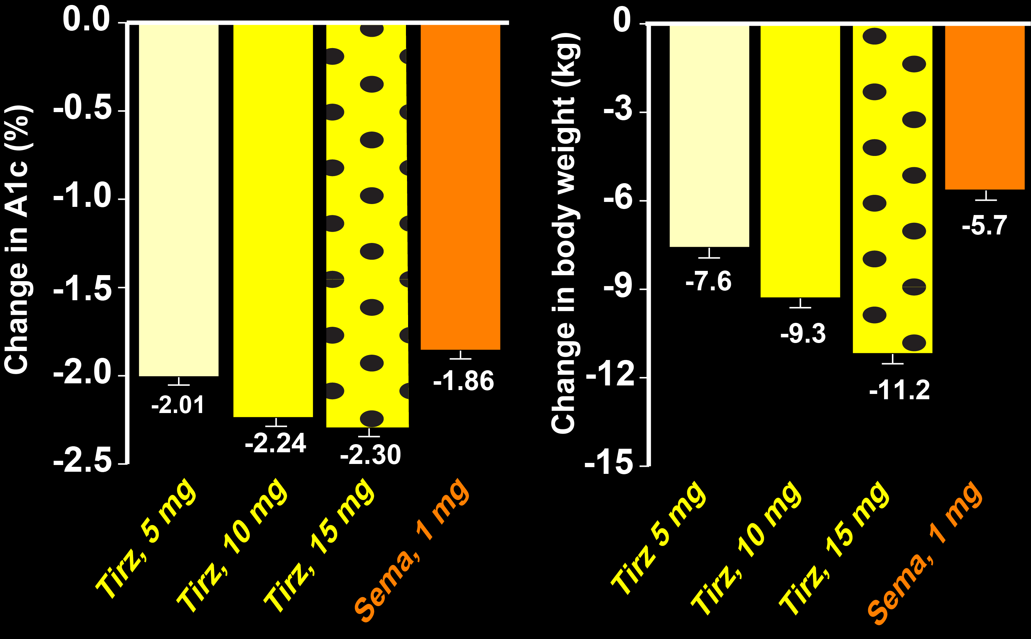
TIRZEPATIDE (MOUNJARO) VERSUS SEMAGLUTIDE (OZEMPIC) IN T2DM
Frías JP et al, 2021 Jun 25. doi: 10.1056/NEJMoa2107519. Online ahead of print
2.0

Slide 22
OMINOUS OCTET-GLP-1 RAs
GLP1
Decreased Incretin Effect
GLP1
Decreased Insulin Secretion
Increased
Lipolysis
Islet–α cell
GLP1
HYPERGLYCEMIA
Increased
Glucose
Reabsorption
Increased Glucagon Secretion
Increased
Decreased Glucose
Uptake
HGP
Neurotransmitter Dysfunction
GLP1
GLP1
GLP1

Slide 23
GLP-1 RAs and
CV DISEASE

Slide 24
EFFECT OF ONCE WEEKLY EXENATIDE ON MACE IN EXSCEL
EFFECT OF LIRAGLUTIDE ON MACE IN LEADER
EFFECT OF
SEMAGLUTIDE ON MACE
IN SUSTAIN-6
EFFECT OF
DULAGLUTIDE
ON MACE
IN REWIND
20 -
N = 9,340
HR = 0.87
95% Cl, 0.78-0.97
P=0.01
10 -
N = 3297 HR = 0.74
95% Cl, 0.58-0.95
P = 0.02
18 -
N = 14,752
HR = 0.91
95% CI =0.83-1.00
P=0.06
18 -
N = 9,901
HR = 0.88
95% CI = 0.79-0.99
P = 0.026
8 -
15 -
15 -
12 -
12 -
Placebo
6 -
Placebo
Placebo
Placebo
10 -
Cumulative (%)
Patients with Events (%)
9 -
4 -
6 -
6 -
5 -
Liraglutide
2 -
Semaglutide
Exenatide
Dulaglutide
3 -
0
0
-
-
-
-
-
-
-
-
-
-
-
-
-
-
-
-
-
-
-
-
-
-
0
0
0
12
24
36
54
-
0
1
2
3
4
5
6
0
32
64
96
109
0
1
2
3
4
5
Years
Weeks
Years
Years
Marso et al, NEJM June 13, 2016
Marso et al, NEJM, Sept 16, 2016
Holman et al, NEJM, Sept 13, 2017
Gerstein et al, Lancet, June 2019

Slide 25
GLP-1 RAs
and
CHRONIC KIDNEY DISEASE

Slide 26
EFFECT OF SEMAGLUTIDE ON CHRONIC KIDNEY DISEASE IN T2D PATIENTS: THE FLOW STUDY
Perkovic V et al, NEJM 391:109-121, 2024
30 -
HR=0.76
95% CI, 0.66-0.88
P=0.0003
N=3,533
20 -
Placebo
10 -
Semaglutide
0 -
-
-
-
-
-
-
-
-
-
0
6
12
18
24
30
36
42
48
Months

Slide 27
GLP-1 RAs
and
OBESITY

Slide 28
SEMAGLUTIDE (2.4 mg) PRODUCES MARKED WEIGHT LOSS IN OBESE SUBJECTS
BODY WEIGHT
CHANGE (%)*
WEIGHT LOSS
≥15%
STUDY
SUBJECTS*
STEP 1
Obese, non-diabetic
50.5%
-14.9%
STEP 2
Obese T2DM
-9.6%
25.8%
STEP 3
Obese, non-diabetic + Intensive Behavior
-16.9%
55.8%
Davies, Lancet 2021; Rubino, JAMA 2021; Wadden, JAMA 2021; Wilding, NEJM, 2021
*4,300 obese subjects with 1 comorbidity; 68 weeks duration of therapy

Slide 29
STEP 4: EFFECT OF SEMAGLUTIDE ON HEART DISEASE AND STROKE IN OVERWEIGHT/OBESE NONDIABETIC SUBJECTS WITH PRIOR CV DISEASE
Subjects:
~17,500 nondiabetic (A1c < 6.5%); overweight/obese (BMI ≥ 27); established CVD (MI, stroke, PVD, revascularization, amputation); age > 45 years
Study Design:
Double blind, placebo controlled Semaglutide (2.4 mg sc) vs Placebo Duration: Follow-up = 31-59 months
Primary Outcome:
MACE
Secondary Outcomes:
CV death; all-cause death; expanded composite CV outcome; heart failure composite; 5-component composite nephropathy outcome; time to A1c ≥ 5.7%; others
Diabetes Therapy, 2021 (PMID: 33417153)

Slide 30
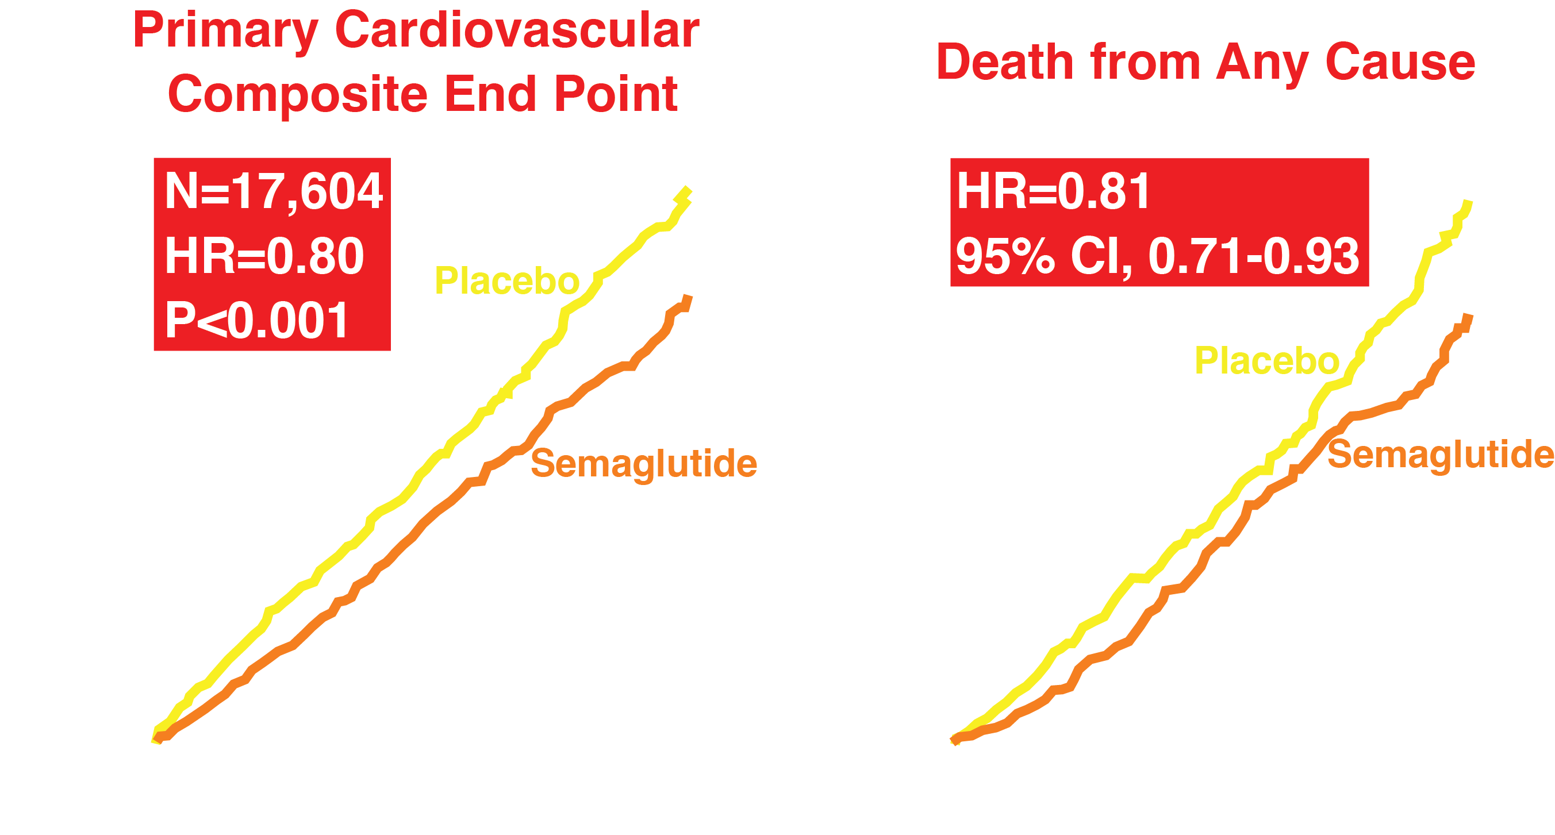
SEMAGLUTIDE AND CARDIOVASCULAR OUTCOMES IN OBESE NON-DIABETES SUBJECTS (N = 17,500)
Lincoff AM et al, NEJM, November 23, 2023
Months
Months
Notes:
Key Point: The results of the primary composite endpoint were consistent both in patients with and without diabetes.
Talking Points
Results for the primary composite endpoint in favor of dapagliflozin compared with placebo were consistent across all prespecified subgroups¹
Looking specifically at subgroups by diabetes status²
In patients with T2D, the event rates were 10.4% and 15.8% over the duration of the study for dapagliflozin and placebo, respectively (HR: 0.64). This represents an absolute risk reduction of 5.3% and a relative risk reduction of 36%
In patients without T2D, the rates were 6.5% and 11.8%, respectively (HR: 0.5), representing an absolute risk reduction of 5.4% and a relative risk reduction of 50%
References
Heerspink HJL, et al. N Engl J Med 2020;383:1436–1446
Wheeler DC, et al. Lancet Diabetes Endocrinol 2021;9:22–31

Slide 31
GLP-1 RECEPTOR AGONISTS
Convert individuals from
FOOD ADDICTION
to
DRUG ADDICTION

Slide 32
DPP-4 INHIBITORS

Slide 33
EFFECT OF SAXAGLIPTIN ON HbA_{1c}: CHANGE FROM PLACEBO (BASELINE HbA_{1c} ≈ 8.0%)
Int J Clin Prac 63:1395, 2009; Diab Ob Metab 10:376, 2008
Diab Care 32:1649, 2009; JCEM 94:4810, 2009
0
Δ HbA_{1c} (%)
-0.5
-0.63
-0.64
-0.76
-0.83
-1
DRUG NAIVE
GLYBURIDE
METFORMIN
PIO/ROSI
ADDITION OF SAXAGLIPTIN TO:

Slide 34
DPP-4 INHIBITORS WERE LARGELY CV NEUTRAL
Saxagliptin (SAVOR trial)¹
Alogliptin (EXAMINE trial)²
Sitagliptin (TECOS trial)³
Primary endpoint: Composite of CV death, myocardial infarction, or ischemic stroke
Primary endpoint: Composite of CV death, nonfatal myocardial infarction, or nonfatal stroke
Primary endpoint: Composite of CV death, nonfatal myocardial infarction, nonfatal stroke, or hospitalization for unstable angina
Incidence of primary
endpoint events (%)
Incidence of primary
endpoint events (%)
Patients with events (%)
20
20
Hazard ratio: 1.0 (95% CI: 0.89, 1.12)
P=0.99 for superiority
Hazard ratio: 0.96 (upper boundary
of the one-sided repeated CI: 1.16)
P=0.32 for superiority
20
Hazard ratio: 0.98
(95% CI: 0.89, 1.08)
P=0.65
15
15
15
Placebo (n=8212)
10
Saxagliptin (n=8280)
10
10
Placebo (n=7339)
Placebo (n=2679)
5
5
5
Sitagliptin (n=7332)
Alogliptin (n=2701)
0
0
0
0
6
12
18
24
30
0
6
12
18
24
30
0
12
24
36
48
Months
Months
Months
Adapted from Scirica B, et al. N Engl J Med 2013;369:1317–1326;
2. Adapted from White W, et al. N Engl J Med 2013;369:1327−1335;
3. Adapted from Green JB, et al. N Engl J Med 2015;373:232–242
Notes:
The effect of DPP4 inhibitors on CV outcomes has been investigated in several studies. These agents have been shown to be CV neutral and have nor increased the risk of MACE, with superimposable curves from clinical trials.

Slide 35
SGLT2 INHIBITION:
A NOVEL TREATMENT STRATEGY FOR TYPE 2 DIABETES MELLITUS
Dapagliflozin
Canagliflozin
Empagliflozin
Ertugliflozin
Sotofliglozin

Slide 36
How do the SGLT2 inhibitors induce glucosuria?

Slide 37
RENAL HANDLING OF GLUCOSE
(180 L/day) (1000 mg/L) = 180 g/day
Glucose
SGLT 2
S1
S GL T 1
S3
90%
10%
NO GLUCOSE
Notes:
Slides 51 through 69

Slide 38
RENAL GLUCOSE HANDLING IN DIABETES
HbA1c (%)
DeFronzo et al,
Diabetes Care 36:3169-76, 2013
9.5
5.0
5.0
6.5
7.5
8.5
Urinary Glucose Excretion
100
180
205
220
240
260
Plasma Glucose Conc (mg/dl)

Slide 39
OMINOUS OCTET
SGLT2i
Decreased Incretin Effect
Decreased Insulin Secretion
Increased
Lipolysis
SGLT2i
Islet–α cell
HYPERGLYCEMIA
Increased
Glucose
Reabsorption
Increased Glucagon Secretion
Increased
Decreased Glucose
Uptake
HGP
Neurotransmitter Dysfunction
SGLT2i
Diabetes 58:773-795, 2009

Slide 40
SGLT 2 INHIBITION: MEETING UNMET
NEEDS IN DIABETES CARE
Corrects a Novel
Pathophysiologic
Defect
Reduces
HbA_{1c}
Complements
Action of Other
Antidiabetic
Agents
Improves
Glycemic
Control
and CVRFs
Promotes
Weight Loss
Reduces
Blood
Pressure
Reversal of
Glucotoxicity
No
Hypoglycemia

Slide 41
SGLT2 INHIBITORS and CARDIOVASCULAR DISEASE

Slide 42
EFFECT OF EMPAGLIFLOZIN ON HOSPITALIZATION FOR HEART FAILURE
EFFECT OF Empagliflozin ON MACE IN EMPA-REG
EFFECT OF EMPAGLIFLOZIN ON CV DEATH IN EMPA-REG
20
-
7
Hazard ratio=0.86
(95% CI, 0.74- 0.99)
p=0.004
Hazard ratio = 0.62
(95% Cl, 0.49-0.77)
P<0.00l
Hazard ratio = 0.65
(95% Cl, 0.50- 0.85)
P=0.002
8 -
6 -
15 -
-
5 -
6 -
N = 7,020
Placebo
-
4 -
Placebo
10 -
Placebo
4 -
Patients with Events (%)
3 -
-
2 -
5 -
Empagliflozin
2 -
Empagliflozin
1 -
-
Empagliflozin
0
0
0
-
-
-
-
-
-
-
-
-
-
-
-
-
-
-
-
-
-
-
-
-
-
-
-
0
12
24
36
48
0
12
24
36
48
0
12
24
36
48
Months
Months
Months
Zinman et al, NEJM, Sept 20, 2015
Zinman et al, NEJM, Sept 20, 2015

Slide 43
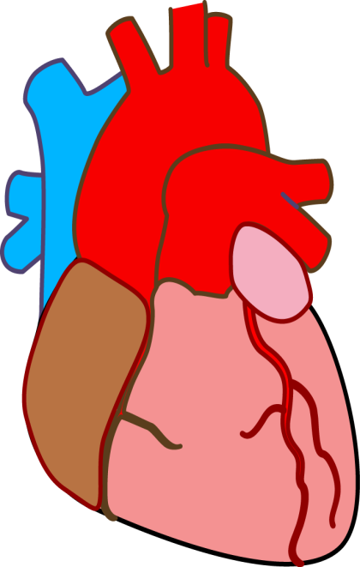
SGLT2 Inhibitors and CV Benefits: Potential Mechanisms
Insulin Resistance
Blood pressure &
Heart rate
Plasma
Volume
Glucose
Arterial stiffness
Weight loss and reduced visceral fat
SNS activity
Inflammation & Oxidative stress
Uric acid
Ketones
Ang 1-7
AT₂ receptor
Mitochon
fn/number
Na⁺H⁺
Exchanger
Hct/Erythro-
poietin
LV Mass
DeFronzo RA et al, Nature Nephrol Rev 13:11-26,
Notes:
SGLT2-inhibitors are known for their increased glucosuria, which produces osmotic diuresis leading to reductions in blood pressure.^{1,2} Reductions in blood pressure also contribute to reduced arterial stiffness.³ This is also attributed to improved glycemic control, weight loss, volume contraction, diuretic effects, and several potential mechanisms, including vasoactive mediators, anti-inflammatory mediators, and decreased oxidative stress. Blood pressure reductions were seen independent of change in heart rate, which could be related to a relative decrease in sympathetic nervous system tone. Weight loss and glucose control have anti-inflammatory properties, which is proposed to be caused by a reduction in oxidative stress and thus a reduction in inflammatory markers.^{1,3}
SGLT2-inhibition has also been attributed to reduced urinary albumin excretion. This is due to reduced renal hyperfiltration, which causes an increase in arteriolar resistance independent of altering efferent arteriorlar resistance causing a partial correction of abnormally high baseline glomerular hydrostatitc pressure.¹
Increased glucosuria correlates to a caloric loss of 200-300 kcal per day, which results in a weight reduction of ~2-3 kg over 24-52 weeks. Studies have shown that a majority of the weight loss was due to a reduction in visceral fat as well as a reduction on waist circumference, which is an index of central obesity.¹
Small increases in HDL-C along with an increase in LDL-C with simultaneous reductions in TG levels have also been noted with SGLT2-inhibition. The clinical relevance of these lipid changes is yet to be determined.¹

Slide 44
SGLT2 INHIBITORS and DIABETIC NEPHROPATHY

Slide 45
RENAL SPECIFIC COMPOSITE OUTCOME
CREDENCE
DAPA CKD
20
Hazard Ratio = 0.66
95% CI = 0.53-0.81
P < 0.001
N = 4,401
20
Hazard Ratio = 0.56
95% CI = 0.45-0.68
P < 0.001
N = 4,304
16 -
15 -
Placebo
Placebo
12 -
Cum Incidence (%)
Cum Incidence (%)
10 -
8 -
5 -
4 -
Dapaflozin
Canagliflozin
0 -
0 -
0
6
12
18
24
30
36
42
0
4
8
12
16
20
24
28
32
Months
Months
Perkovic et al, NEJM 380:2295, 2019
Heerspink et al, NEJM 383:1436, 2020

Slide 46
2024 ADA/EASD ALGORITHM FOR GLYCEMIC CONTROL
FIRST LINE THERAPY
ADA Standards of Care.
Diabetes Care 2024
ASCVD Predominates
HEART FAILURE Predominates
RENAL DISEASE
Predominates
GLP-1 PA
SGLT2i
SGLT2i
SGLT2i

Slide 47
PROBLEM
Only 15-20% of type 2 diabetic patients have cardiovascular or renal disease
What is the role of SGLT2i, GLP-1, and Pioglitazone in the remaining 80-85%?

Slide 48
PRE- 2018 ADA/EASD ALGORITHM FOR GLYCEMIC CONTROL
A1c Goal < 7.0%
METFORMIN
SU
TZD
DPP4-i
GLP-1
RA
SGLT2i
BASAL
Ins
Diabetes Care 41(Suppl 1):S73, 2018

Slide 49
2024 ADA/EASD ALGORITHM FOR GLYCEMIC CONTROL
A1c Goal < 7.0%
GLP-1
RA
INS-
ULIN
MET
SGLT2i
SU
TZD
DPP4-i
Diabetes Care 46(Suppl 1):S147, 2023

Slide 50
COMBINATION THERAPY IN THE
CARDIO-RENAL-METABOLIC ERA
A1c
MAFLD
CVD
Weight
CKD

Slide 51
EFFICACY OVER 2 YEARS OF EXENATIDE/DAPAGLIFLOZIN VERSUS EXENATIDE OR DAPAGLIFLOZIN ALONE on A1c (DURATION 8)
Jabbour SA et al, Diabetes Care 43:2528-36, 2020
0 -
0.5 -
Decrement in A1c (%)
-1.06
-1.0 -
-1.29
P<0.001
-1.5 -
-1.70
P=0.007
-2.0 -
EXEN/DAPA
EXENATIDE
DAPAGLIFLOZIN

Slide 52
EFFICACY OVER 2 YEARS OF EXENATIDE/DAPAGLIFLOZIN VERSUS EXENATIDE OR DAPAGLIFLOZIN ALONE on CVD (DURATION 8)
Jabbour SA et al, Diabetes Care 43:2528-36, 2020
100 -
P=0.03
75 -
0.76
0.71
Hazard Ratio
0.68
50 -
25 -
0 -
Composite CV Events
MI
All-cause Mortality

Slide 53
DAPAGLIFLOZIN PLUS EXENATIDE PRODUCE AN ADDITIVE EFFECT ON HbA1c AND BETA CELL FUNCTION (DISPOSITION INDEX)
9 -
DeFronzo et al, Diabetes 73 (suppl1):1550 p, 2024
8.4
8 -
7.5
7.5
HbA1c (%)
6.6
*
7 -
6 -
7.02
PLAC
(n=15)
DAPA
(n=25)
EXEN
(n=25)
DAPA+
EXEN
(n=25)
7 -
6 -
5.73
5 -
DI=Matsuda Index
x ΔI₀₋₃₀/ΔG₀₋₃₀
4.37
Disposition Index
3.95
4 -
3 -
2 -
1.83
1.07
1 -
0.7
0 -
DAPA+
EXEN
DAPA
EXEN
DAPA+
EXEN
PLAC
DAPA
EXEN
Day 1
Month 4

Slide 54
Efficacy and Durability of Initial Combination Therapy in T2DM
EDICT
Drug-naïve, new-onset T2DM patients (n=318) were randomly assigned to receive for 3 years:
(1) Initial combination therapy with metformin, pioglitazone, exenatide
versus
(2) Sequential add-on therapy with metformin, glipizide, glargine

Slide 55
Difference in the number of T2DM subjects with HbA1c <6.5 after 3-years in the Triple Therapy versus Conventional Therapy groups
PRIMARY ENDPOINT OF EDICT

Slide 56
TIME-RELATED CHANGE IN HbA1c IN TRIPLE THERAPY AND CONVENTIONAL THERAPY GROUPS
Abdul-Ghani, DeFronzo et al, Diabetes Care 44:433-439, 2021
*P < 0.001
6.9%
HbA1c (%)
Conventional Therapy
6.1%
Triple Therapy
Time (years)

Slide 57
KAPLAN-MEIER PLOT OF TIME
TO TREATMENT FAILURE IN EDICT
1.0 -
Abdul-Ghani, DeFronzo et al, Diabetes Care 44:433-439, 2021
Triple Therapy
(n =157)
0.8 -
0.70
P<0.00001
0.6 -
Cum Survival
Conventional
Therapy (n = 161)
0.4 -
0.29
0.2 -
-
-
-
-
-
-
0
12
24
36
42
60
72
Time (months)

Slide 58
EFFECT OF TRIPLE VS CONVENTIONAL THERAPY ON INSULIN SENSITIVITY AND BETA CELL FUNCTION
Abdul-Ghani, DeFronzo et al. Diabetes Care 44:433-439, 2021
12 -
Baseline
Study End
4
*
*
*P<0.0001
*P<0.0001
9 -
3 -
0 -
Insulin Sensitivity
(Matsuda Index)
Beta Cell Function
(ΔCP/ΔG)₀₋₁₂₀ ÷ IR)
2 -
3 -
1 -
0 -
0 -
Triple Rx
Convent Rx
Convent Rx
Triple Rx

Slide 59
CHANGE IN CAROTID INTIMA MEDIAL THICKNESS IN CONVENTIONAL TEHRAPY AND TRIPLE THERAPY GROUPS
Abdul-Ghani, DeFronzo et al. Diabetes Care 44:433-439, 2021
20 -
15 -
Change in Carotid IMT
(10⁻³ mm)
10 -
P=0.01
5 -
0 -
Conventional
Therapy
Triple
Therapy

Slide 60
DEFRONZO ALGORITHM
SGLT2i
GLP-1 RA
Pioglitazone
Metformin
“IT UTILIZES THE CARDIO-RENAL-METABOLIC DRUGS IN COMBINATION”

Slide 61
Standards of Medical Care in Diabetes, Diabetes Care 45 (suppl 1), pg S132, 2022
“COMBINATION THERAPY”
“Because T2D is a progressive disease, maintenance of glycemic targets with monotherapy is often possible for only a few years. Traditional recommendations have been to use stepwise addition of medications to metformin. However, there are data to support initial combination therapy for more rapid attainment of glycemic goals and longer durability of glycemic effect (53,56)”
(53) Abdul-Ghani, DeFronzo et al, Diabetes Care 44:433-39, 2021
(56) Matthews et al, Lancet 394:1519-29, 2019

Slide 62
THANK YOU!

